Slide 1

Advanced Multimedia System (AMS)
ITU-T Workshop
"The impact of the United Nations Convention on the Rights of Persons with Disabilities on the work of the ITU-T"
Geneva, 2 November 2009
Paul E. Jones
Architect
Cisco Systems, Inc.

Slide 2
What is AMS?
The Advanced Multimedia Systems (AMS), also known as H.325, is the third-generation multimedia system developed by the ITU
  First generation was H.320 (ISDN)
  Second generation was H.323 (IP)

Slide 3
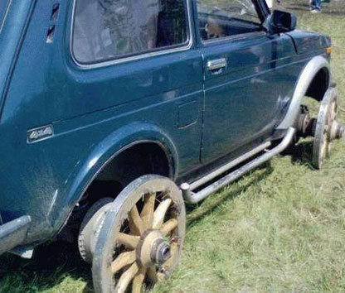
Are We Re-Inventing the Wheel?
We are not re-inventing the wheel, but we do aim to improve upon it.
Advances in technology require us to think about what we have today to see whether it makes sense for the future.
Technology is always changing.
We decided that today’s systems are simply not designed for the more advanced capabilities that we want to enable.

Slide 4
Key Issues with Existing Systems
Hard to introduce new functionality
No standard way to introduce new applications
Accessibility issues were not considered from the outset
Most importantly, existing multimedia systems were solely focused on voice and video communication; we wish to broaden the scope of what H.325 encompasses

Slide 5
Re-Thinking Multimedia Communication
We want to create a platform that would enable all kinds of new applications
We want to enable users to use any number of different devices
It’s not necessarily a “phone”
We want to enable mobility
We will consider accessibility issues

Slide 6
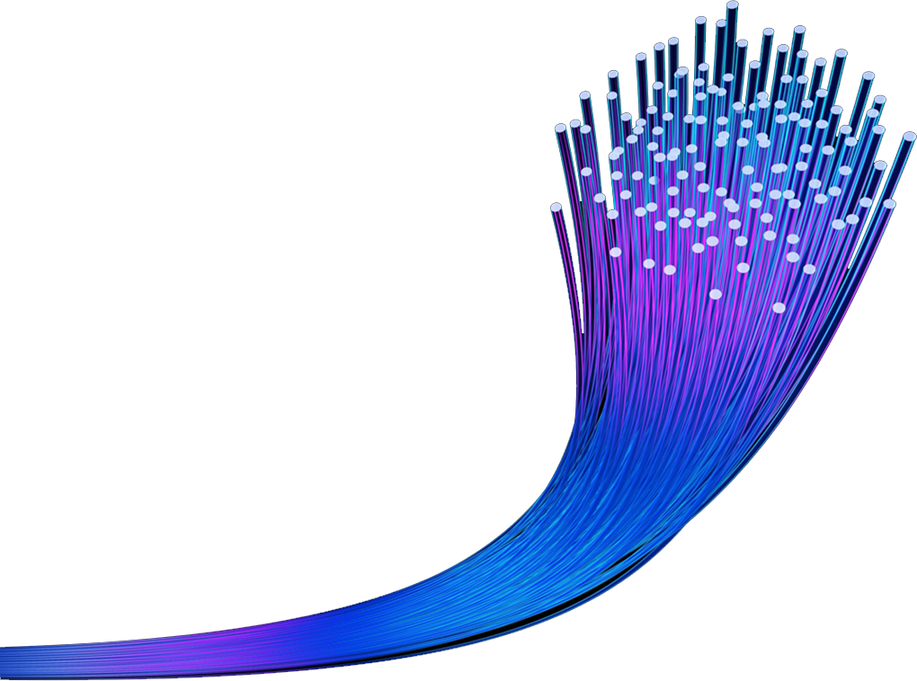
We Want Applications!
Voice
Video
Text (IM and RTT)
Application sharing
Whiteboarding
File transfer
Video streaming
Video games
Streaming audio (e.g., Internet radio)
Flashing lights for the deaf

Slide 7

AMS Will..
Be a new and different
multimedia system
Not be just a Voice over IP system
Enable a union of physically separate devices, like a desk phone, mobile phone, or LCD panel on the wall
Enable multiple applications to work together in order to deliver a rich communication experience

Slide 8
Imagine…

Slide 9
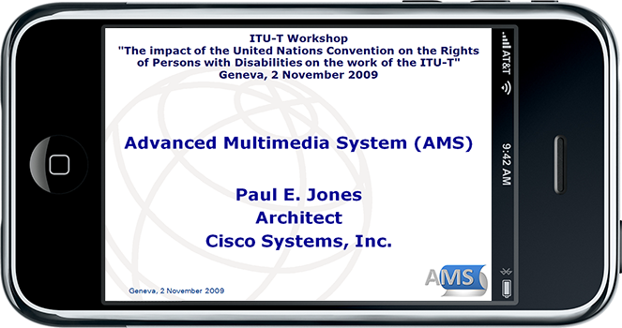
Mobile Content
Being able to view this presentation remotely via your mobile device while the presentation is being given and without having to download the content in advance

Slide 10
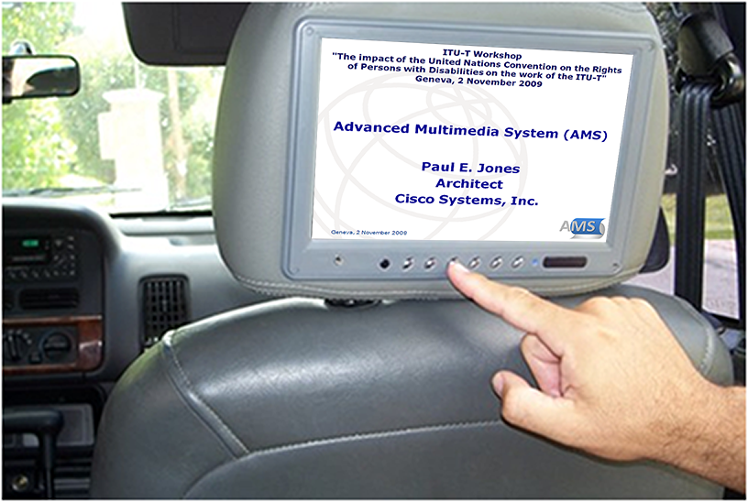
Mobile Content On any Device
Viewing that presentation while riding in the back of a taxi

Slide 11
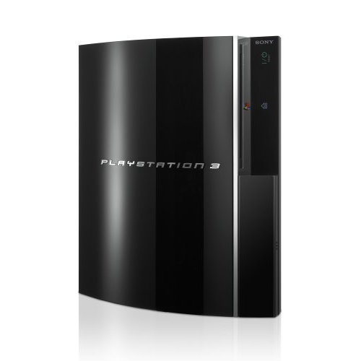
Enabling Interactive Media
Imagine playing interactive video games (or using other applications) as easily as making a phone call
  Using the same communication platform
  Interconnecting devices
  Sharing network resources

Slide 12
Improved Productivity
Imagine initiating in instant messaging session with a colleague
  Click a single button on the computer to enable web conferencing
  Turn on a video screen to interact using sign language
  Turn on an intelligent whiteboard device and jointly collaborate
And imagine doing all of this without initiating multiple different sessions, entering digits, or “joining a conference” – all of this will be automated with H.325

Slide 13
Freedom to Roam
Imagine moving from a mobile call into a telepresence conference by simply placing the mobile device on the table
Imagine taking a video call at any nearby video display device
Imagine sharing your presentation via an in-room projector from your mobile phone, with content sourced from the office

Slide 14
A New Architecture
The user’s device (“container”) is logically separate from the applications, allowing the user to use any number of applications on any number of different physical devices
Any application developer can create new applications
  No more waiting for vendor enhancements
  More vendor choices
  More application choices

Slide 15
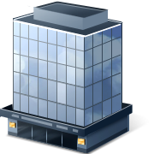
Concept of the Personal Network
Home
Automobile
Work
Devices / applications within
the user’s vicinity
App 1
App 4
App 2
Container
App 5
App 3
App 6
Assemblage: the collection of applications together with a container.

Slide 16
Personal Network in Brief
The Personal Network is comprised of the applications and devices that are within proximity of the user at a given time: at home, in the car, at the office, or wherever
The devices within the Personal Network might allow one to present material via a projector, listen to or view locally generated content, exchange files, etc.
Any application or device within the Personal Network may communicate with other applications or devices in the Personal Network
App 1
App 4
App 2
Container
App 5
App 3
App 6

Slide 17
Network Robot / Connected Home
H.325 enables devices and application in our homes or offices to interact
This is not traditional multimedia communications
Made possible by decoupling the “control” device from the “applications”
Many more devices become “intelligent”

Slide 18
Accessibility Considerations
Accessibility needs were not considered in the development of H.323 and SIP
AMS will allow a device to register and receive a notification of an “alerting” event
  This device could be a lamp that flashes
The same mechanics can drive all kinds of inter-application communication
Given the architecture and applications possible, an assortment of new kinds of automated and human translation services should be possible
  An application could provide real-time speech-to-text
  Applications could invoke services of human translators

Slide 19
A Simple Vision
The network and the devices therein should serve to enhance our lives and better enable people to communicate
The system will be an extensible application platform
The system should enable new modes of communication as people create them, without the need to upgrade Container or network infrastructure for every new application
Implementing and deploying new modes of communication should be simple – the platform deals with the mundane/complex parts
One should be able to utilize a multiplicity of devices
It is time for multimedia systems to advance

Slide 20


Slide 21
Technical Details
The following slides provide some additional technical information
It will not be presented during the meeting, though you are welcome to contact the author for more information
  paulej@packetizer.com (email and Jabber/XMPP)

Slide 22
More on the Container
The “Container” represents the user’s identity to the H.325 network
Container functionality may be integrated into network elements (e.g., traditional IP PBX), but would most likely be in a mobile device carried by the user (e.g., a mobile internet communicator)
A Container does not have application intelligence
  Serves as a timing source for synchronization
  Coordinates communication within the assemblage and across the network
  Does not know or care what applications are doing
  May serve as a proxy for media

Slide 23
H.325 Terminal Interfaces
Interface A – Container / Network signaling
Interface B – Container / Application signaling
Interface C – Media flows
Interface D – Media proxy interface
Network
Interface A
Interface C
Interface C
Container
Interface B
Note: While the picture shows the “App Sharing” application with two Interface C’s, an application would only send media directly to the network or via the media proxy as dictated by the Container.
Interface D
App Sharing
Media Proxy
Interface C
Application Device
User’s Mobile Device

Slide 24
Signaling Between Remote Applications
App 1
Network
App 1
App 2
Container
Container
App 2
App 3
App 3
Applications send messages to the container that then get directed to the peer application
The container multiplexes messages over a single signaling connection (if destined to the same remote peer)
The receiving container then delivers messages to the remote application based on a known association
Note: Media does not usually flow through the container. Rather, it flows end-to-end between communicating applications. However, the container may provide a media proxy function to enable end-to-end media flows when no other path exists.

Slide 25
The Applications
Anything you can imagine
Implement a consistent and predictable interface
May be running on the same or different physical devices
Applications may interact with multiple containers
Fully distributed, yet centrally controlled (from the user’s perspective)

Slide 26
More on Applications
Applications like voice, video, video games, file transfer, and whiteboard are enabled via separate applications that may be co-resident with the container or exist on physically separate devices
New applications may be introduced without changes to the container or network elements
Applications may be upgraded independently of other applications
Applications can communicate with other applications within the assemblage (locally) or with applications across the network

Slide 27
Application Handover
Moving from voice on a mobile to Telepresence
  Imagine walking down the hall talking on a mobile phone
  Walk into a Telepresence conference room
  Place the mobile phone on the desk
  The call then transitions automatically from voice to Telepresence with HD video, audio, and presentation
Content To Go, and Taken on the Go
  Imagine walking up to a kiosk where a video is playing
  Press a button on your mobile device and the video moves from the kiosk to the Container (not a copy, per se, but the mobile device is now streaming content from the network or has it “paused”)
  Walk into your living room and press a button to transition that content from the mobile device to your HD TV

Slide 28
Network Facilities
Application functionality may also be realized with local elements that are within the user’s proximity and with functionality from the cloud
  Suppose one has a traditional TV with a set-top box. One could then have a video “receiver” in the cloud. Browsing video content available from any number of sources, that content could be sent to the cloud-based video receiver and then delivered to the traditional TV
Network facilities might facilitate transcoding
Network facilities would enable multi-user conferencing

Slide 29
Personal Network and Mobility
When a user moves from place to place, the physical components of the Personal Network might change
  The projector or display at the office is great
  The projector or display at a customer site is not so great
Though physical components might change, the interaction and experience should be consistent; there should only be an enhanced or degraded performance based on the quality of the components
Different applications used for any kind of communication, whether it is within a Personal Network or a Internet network, is referred to as an “Application Set”

Slide 30
Other Important Concepts
Event notification framework that will allow applications (local or remote) to be notified of certain events
  When a “call” arrives, a “lamp application” may be notified so that it may flash to alert the deaf user of an incoming “call”
  Network-based applications will be made aware of when you arrive home from the office and could turn on soft background music
Application control interface for any application is “remotable” to any other suitable display
  This is envisaged as being implemented via XHTML
  One should be able to control the TV from the container or control a video projection system from a PC, as examples

Slide 31
The Protocol
It will be different than the previous generation
  An interface between applications and the container
  An interface between the container and the network
  ITU will define a core set of applications following a similar design approach, but since the system imposes few constraints, application developers have a lot of flexibility in how they design applications
Protocol will be defined using XML
  Programmers already know how to work with XML
  H.325 will likely use Efficient XML Interchange (EXI) for XML compression (from the W3C)*
* Still under discussion

