Slide 1
A Concept for the Advanced Multimedia System (AMS)
Paul E. Jones
Rapporteur ITU-T Q12/16
July 30, 2007

Slide 2
Nature of AMS
AMS is a forward-looking project initiated by ITU-T SG16 to develop a new multimedia system that will significantly expand on the capabilities available in existing multimedia systems. SG16 is collecting requirements and, consequentially, the final product may differ than what is presented here.

Slide 3
Objectives
Improve the end user experience
Enable innovative applications
Enable mobility
Enable multimedia
Make it easy to use
Improve productivity
Ease application and service development

Slide 4
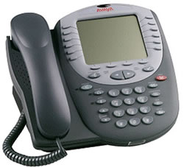
What VoIP Delivered
New devices (IP phones and soft phones)
Convergence of the voice network and the data network (great!)
“Fixed phone” mobility (via the IP network)
Free calls to other VoIP users
Reduced toll rates around the world
The user’s perspective: “yet another telephone”

Slide 5
We Can Do More
IP networks hold the potential for so much more functionality than what was possible before. We should not be content with merely enabling functionality that was already possible with the PSTN!

Slide 6
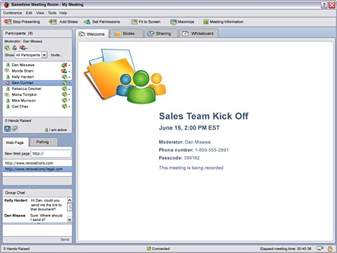
Imagine…
Making a call and having application sharing effortlessly available as part of a voice conversation

Slide 7
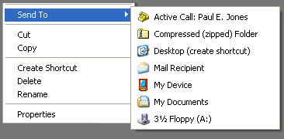
Imagine…
Making a call and sending a file to the other user, simply by right-clicking and choosing “Send To” and selecting the person’s name

Slide 8
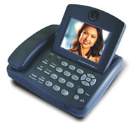
Imagine…
Making a call and sending text along with voice or using video with ease

Slide 9
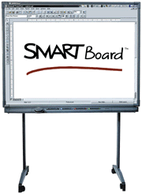
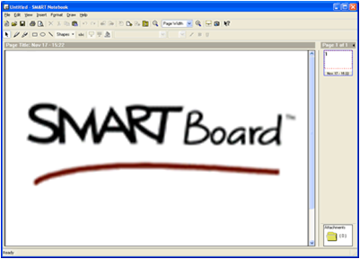
Imagine…
Holding a conference call with several people and sharing slides or using an electronic whiteboard

Slide 10
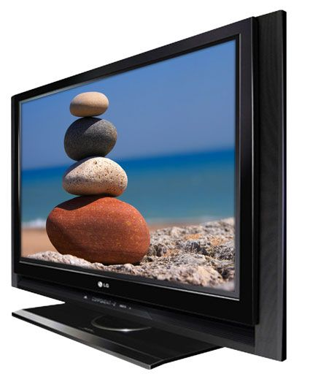
Imagine…
Being able to use your phone to turn any flat panel LCD screen into your video display device

Slide 11
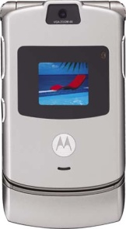
Imagine…
Being able to use your mobile phone to select movies and watch them on either your mobile phone or your HD TV, and even switch between one device or the other

Slide 12
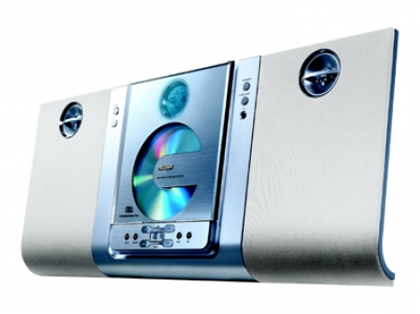
Imagine…
Being able to listen to Internet radio using your phone to select the “channel” and speakers across the room to play the music

Slide 13
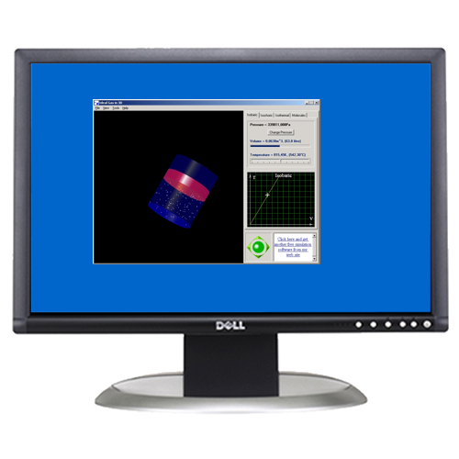
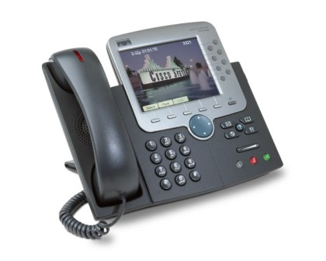
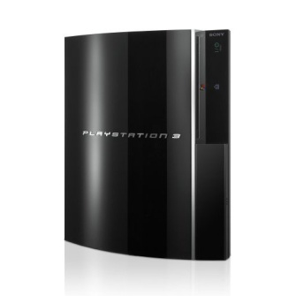
Imagine…
A world of interactive, multi-player gaming that is consistently enabled through a real-time IP-communication system

Slide 14
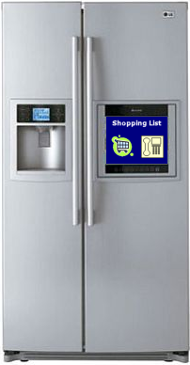
Imagine…
Being able to connect your phone with your refrigerator so you can drag your shopping list onto a phone icon to send that list to your courier

Slide 15
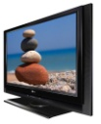
Imagine…
Being able to use any combination of hardware devices to enable countless new multimedia applications to work seamlessly together

Slide 16
Sample AMS Applications
Traditional voice and video
Whiteboard
File transfer
Application sharing
Text messaging
Video streaming (e.g., IPTV)
Gaming
Multi-user data conferencing
Streaming audio (e.g., “IP radio”)
“Create your own and plug it in”

Slide 17
Realizing the Vision
We must logically separate applications from the user’s network interface device
The “phone” might be a control tool, but may or may not be the user’s input device or display device
Applications may be co-resident with the “phone” or they may be on separate physical devices
A residential gateway device might provide control for a host of applications within the home, including voice telephone devices
We must define a system that encourages creation of new services through integration of new applications
We must make the system as easy to use as possible, otherwise it will not be utilized

Slide 18
History of Multimedia Systems
First Generation Protocol – H.320
ISDN videoconferencing
Second Generation Protocols – H.323, SIP
Focused on videoconferencing on the LAN (H.323) and voice over the Internet (SIP)
Roles expanded for both to address international voice and video transmission, presence, and instant messaging

Slide 19
Why a New System?
Second generation systems are now 11 years old
Both H.323 and SIP were introduced in 1996
Neither were focused on application or device enablement
Second generation systems only scratched the surface of what is possible with IP communication
Second generation systems were limited in scope to (primarily) delivering voice and video service
Second generation systems are “monolithic” applications to which adding any new functionality is quite complicated
QoS, Security, and NAT/FW traversal issues were an afterthought in second generation systems, and it shows

Slide 20
Advanced Multimedia System
Third Generation – AMS
New project in ITU-T Q12/16
Endpoint decomposition
Application enablement
Collaborate more intuitively
Increase productivity
“Any device, Anywhere, Any time”

Slide 21
Comparison of 2G and 3G
2G – “Monolithic”
3G – “Distributed”
All features offered by the user’s device are either integrated into the software or are integrated through proprietary interfaces. Adding any new feature means upgrading the device.
The user’s device may sport a few basic applications, but many applications can be added through interfaces with external devices, including TVs, PCs, PDAs, and so on

Slide 22
AMS Will…
Enable new applications with minimal or no changes to deployed infrastructure
New capabilities for users
New revenue opportunities for service providers
Enable third-party application developers to add new functionality to the system
Truly enable multimedia communication that goes well beyond just voice and video
Address QoS, security, and NAT/FW issues from the outset

Slide 23
AMS Architectural Components (This is a concept and certainly not definitive)
“container”
This is the device that represents the user to the network (e.g., a desk phone, mobile phone, or softphone application)
Application Protocol Entities (APEs)
These are the applications that register with the container to provide the user with voice, video, and data collaboration capabilities
Service Nodes (SNs)
These are the network entities that enable the container to establish communication with a remote entity, facilitate NAT/FW traversal, and provide other network-based services
Application Servers (AS)
These are elements in the network that provide various services, which might include IPTV, interactive gaming, multipoint conferencing, and so forth

Slide 24
The “Container”
Is the primary contact point for the user
Handles such functions as user and APE registration with the network
Is responsible for securing the signaling paths between the container and the network (or remote parties)
With secured signaling paths, enables APEs to exchange keys for media encryption
Knows nothing about the APEs and what they do
Knows only how to establish a session between two users
Is the “control point” for the user
Set privacy settings
Manage APEs associations
Invoke applications
Move an active application from one device to another (e.g., “move” a video stream from a mobile device to an HDTV)

Slide 25
Service Nodes
Handle user registration and authentication
Perform address resolution
Route signaling and media for the container and APEs (directly or via a service node)
Facilitate NAT/FW traversal
Interface with Application Servers
Provides a point of network control\
Etc.
It is fair to think of “service nodes” as devices similar to gatekeepers, SIP proxies, SBCs, TURN servers, and STUN servers

Slide 26
Application Protocol Entities
Responsible for providing a particular application service
A standard set of applications will be defined
Third parties can develop new applications and plug them into the system
Depends on the “container” for session establishment
Register with the “container”, not the network
The “container” informs the network of the user’s capabilities
There is security between the “container” and APEs

Slide 27
Application Protocol Entities (cont)
APEs can register with multiple “containers” on multiple devices
Enables your PC to be a “container” and your IP phone to be another “container”, yet both can utilize the whiteboarding application on your PC
Enables your mobile phone to serve as the “container”, your Bluetooth headset serve for voice, and any HD TV screen to serve to deliver video
Applications are invoked through user interaction with the “container”
A standard “container” and “APE” interface (over a variety of access types) will enable a wide variety of applications that are not possible today

Slide 28
Application Servers
Network-based application servers that provide service
Application servers will have “container” logic, as well as integrated or distributed application functionality
Service providers will be able to deliver multimedia services directly to end users via these network-based servers, including
IPTV
Broadcast IP radio
News transmission
Stock quotes
Voice and video conferencing
Content distribution

Slide 29
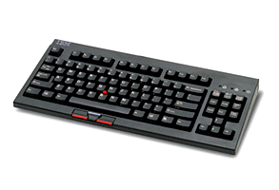
A “Container” and APEs
“share_app”
Standardized interface(s) between the container and APEs
“voice_app”
Another “Container”, but not being used as part of this conference. “share_app” registered with both containers.
“Container”
APEs and “containers” may find each other through static provisioning, technologies like Bluetooth, dynamic service discovery protocols, etc. The “container” will identify APEs and allow the user to authorize the relationship.

Slide 30
Typical Offices
“share_app”
“share_app”
“Container”
“voice_app”
“Container”
“voice_app”

Slide 31
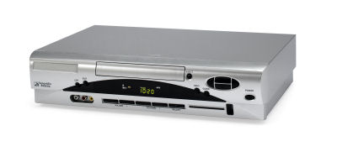
Home Entertainment Equipment = Home Conferencing Equipment
“Containers”
Through this interface, the mobile phone now becomes the user’s tool for selecting video programming, while the video appears on the TV
“voice_app”
“video_app”
“audio_app”
Use of the “audio_app”, rather than “voice_app”, is intentional here

Slide 32
Signaling and Media Flows
App1
Container
App2
These might all be separate physical devices
Signaling
Media
Media generally flows directly between applications, not through the container
Service
Node
A user-network interface (UNI) is defined between the “container” and the “service node”
Application signaling goes from the application, through the container, and to the service nodes
App1
Container
App2

Slide 33
Application Handover
Multiple instances of the same kind of application may be registered with the container (e.g., multiple “voice” devices may be at the user’s disposal)
A user may “move” the “voice” part of a conference from a mobile handset to a desk phone or PC, for example, without transferring or otherwise disrupting the conference
Video may be moved from one device to another (e.g., the handset to a HD TV screen)
Application handover would be transparent to others in a conference

Slide 34
Example of Network-based Streaming Video Service
Audio and Video Streams are not
required to flow through the phone
Application
Server
Application
Server
Application
Server
Service
Node

Slide 35
Example of Network-based Multipoint Data Conferencing Service
Application
Server
Application
Server
Application
Server
Service
Node

Slide 36
Packetizer
®

